Slide 1

Mongoose
REST API DEVELOPMENT
কিঃ
Mongoose an elegant MongoDB object modeling for Node.js
কেনো ব্যাবহার করবোঃ
Provides schema-based data modeling solution
Type casting
Validation
Query building
Business logic.

Slide 2
Mongoose
REST API DEVELOPMENT
How to Start
Install mongoose
Create Database connection
Create your first mongoose model
Work with mongoose model

Slide 3
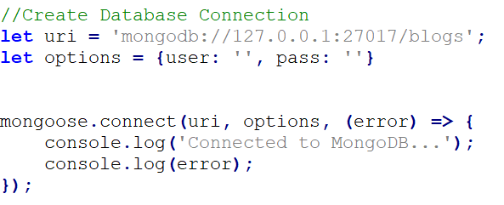
Mongoose
REST API DEVELOPMENT
Create Database Connection

Slide 4
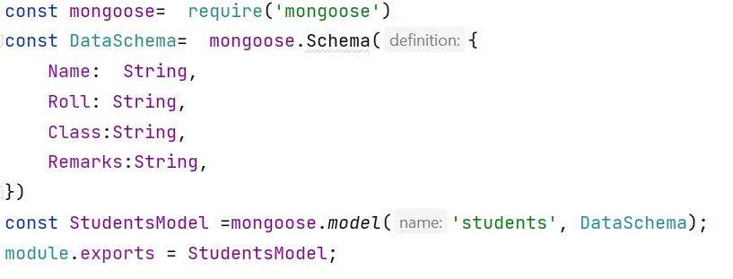
Mongoose
REST API DEVELOPMENT
Create your first mongoose model

Slide 5
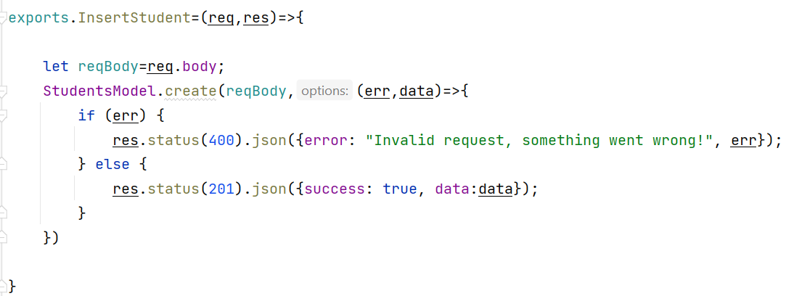
Mongoose
REST API DEVELOPMENT
Work with mongoose model (Insert)

Slide 6
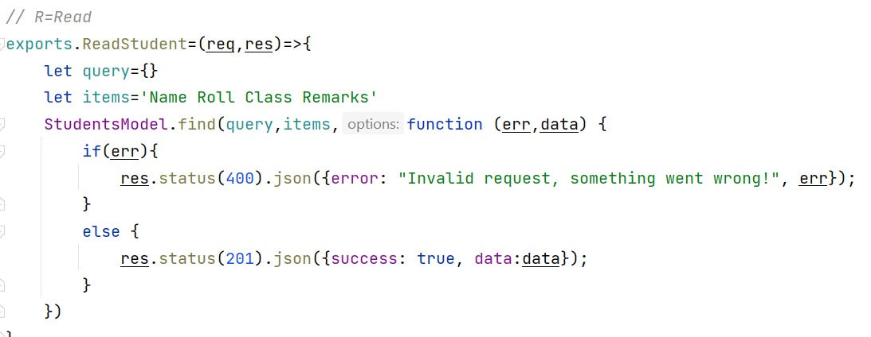
Mongoose
REST API DEVELOPMENT
Work with mongoose model (Read)

Slide 7
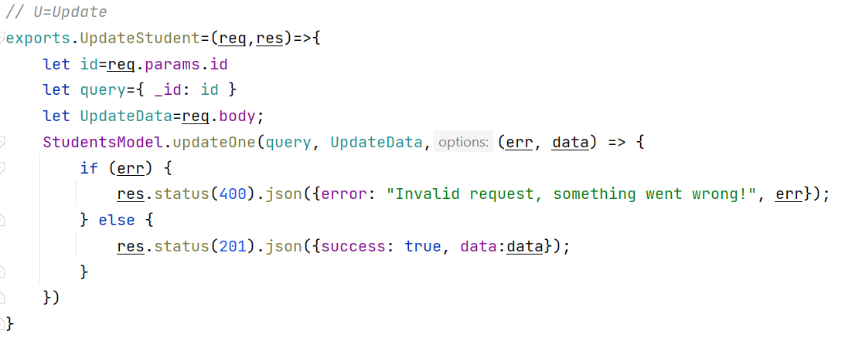
Mongoose
REST API DEVELOPMENT
Work with mongoose model (Update)

Slide 8
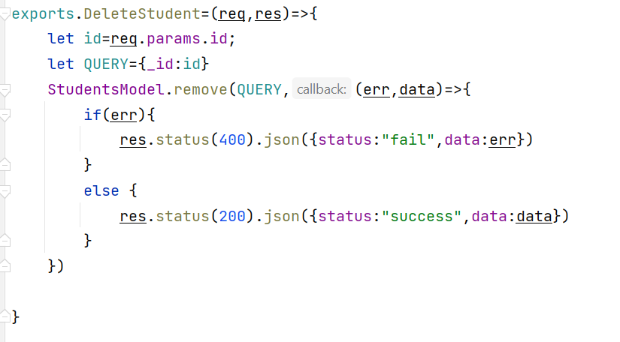
Mongoose
REST API DEVELOPMENT
Work with mongoose model (Delete)

Slide 9
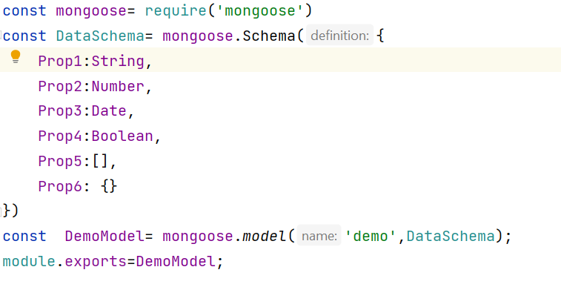
Mongoose
REST API DEVELOPMENT
SchemaTypes:
String
Number
Date
Buffer
Boolean
Mixed
ObjectId
Array
Decimal128
Map

Slide 10

Mongoose
REST API DEVELOPMENT
Default Value & Version Key

Slide 11

Mongoose
REST API DEVELOPMENT
Type Casting Validation
Required Validation
Unique Validation
Min-Max Number Validation

Slide 12
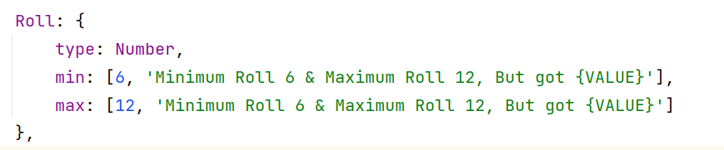
Mongoose
REST API DEVELOPMENT
Custom Error Message Validation
Enumerated type Validation

Slide 13
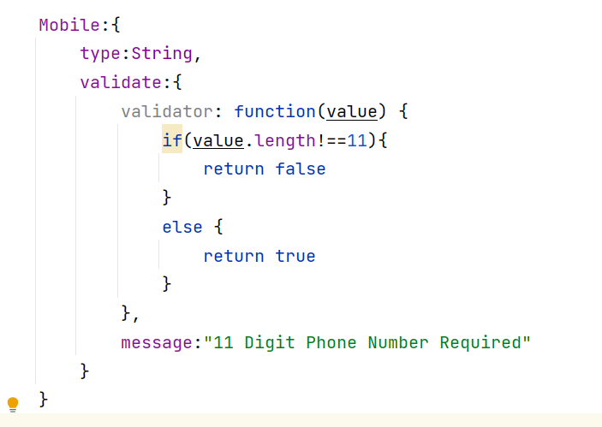
Mongoose
REST API DEVELOPMENT
Custom Validation

Slide 14
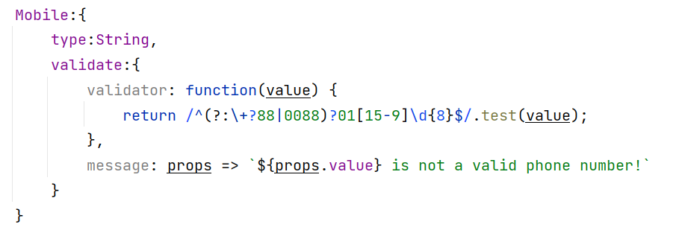
Mongoose
REST API DEVELOPMENT
Regex Validation

